Slide 1
Predicting Billboard Performance
Youssef Lazrak
Owen Liu
Ilias Miraoui
Sophie Pealat
Jacques-Olivier Weulassagou

Slide 2
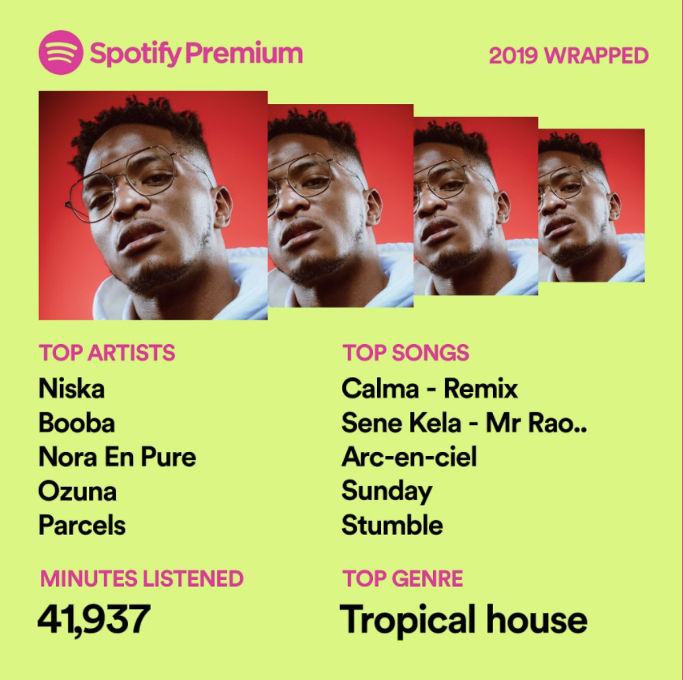
Music in our Lives
According to the IFPI 2019 Music Report:
On average, people are spending around 18 hours a week listening to music
54% of respondents say they love or are fanatical about music
Notes:
30 seconds:
Vertical take-off about how music is so prevalent in our lives and how we are all so passionate about it ☺
Make a quick joke about 42K minutes listened in a year (that’s like a Month in the year) and questionable tastes…

Slide 3
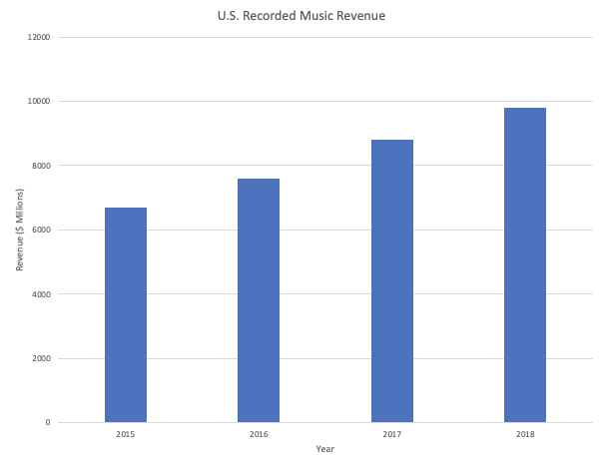
Potential Impacts
$9.8 billion
Predicting Music’s popularity could help:
Influence Music Creation
Improve Record Companies’ Portfolio Management
Optimize Advertising Spend
Influence Festival Organization
Notes:
1 minute:
Music Industry is growing tremendously and is huge (Spotify has over 100 million subscribers!!)
We think this project could affect plenty of points of the chain: from creation to portfolio management, to advertising to festival organization.

Slide 4

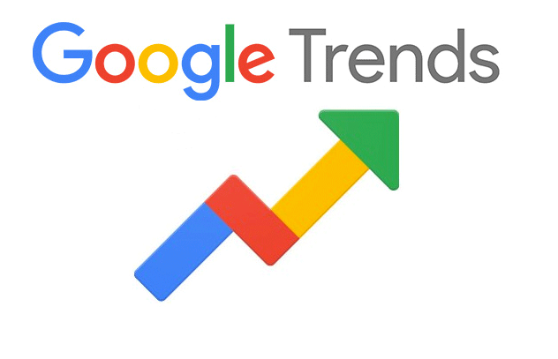


Sources of Data
Billboard : Billboard charts from 1998 to 2019 (100 songs/chart)
Spotify API : internal characteristics of songs
RIAA website : song certifications history
Google Trends : popularity of the artist
28 variables : 8 categorical, 20 continuous
Notes:
1.5 minutes:
No clean dataset available…
A lot of of our work has been gathering all the data and putting it altogether.

Slide 5
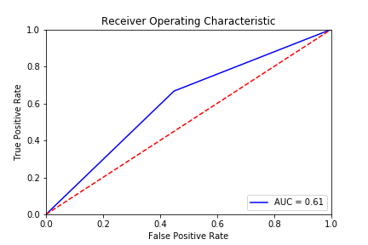
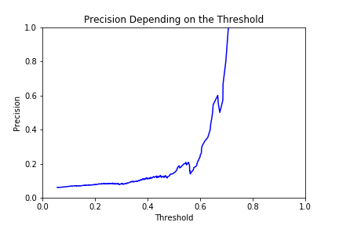
Logistic Regression
Split the Data 80/20 (6287/1602)
Predicting 1 if the song reaches the top 10, 0 otherwise
Despite attempting undersampling and oversampling, results are still mitigated in our attempt to maximize precision:
With a threshold of p=0.7 for test set:
[1506, 0]
[ 92 , 4]
Potential solutions:
Attempt more complex models
Attempt PCA to avoid overfitting on more complex methods
Try to Predict a larger “Top” (Top 25? Top 50?)
Notes:
30sec/1minute:
Quickly talk about class imbalance and how SMOTE allows for oversampling managing class imbalance because otherwise, it would just be our baseline…

Slide 6
The Way Forward
Include data from Google Trend : train model + predictions
Additional Variable selection
Principal Component Analysis for Complex Models
Run additional models to improve performance (CART, RF, Boosting, Neural Network)
Is inference possible?
Notes:
30sec/1minute:

